Slide 1

DM4ML
Assignment 1
Name | BITS ID
Ansari Abdul Rahim Shahabuddin | 2025AE05905
Roopal Jaiswal | 2025AE05413
Bodhanapu Archeshma | 2025AE05825
Anup Kumar Sarkar | 2025AE05010

Slide 2
Contents
The Business Problem
Pipeline Architecture & Tech Stack
Task-Wise Breakdown (1 to 10)
Tools Used
Input
Summary
Output
Screenshots

Slide 3

End-to-End Data Management Pipeline
RecoMart
Building a Scalable Recommendation Engine
Subject: Data Management for Machine Learning (S2-25_AIMLZG529)
(MTech Semester II, May 2026)

Slide 4
The Business Problem
Objective: Enhance customer engagement and increase cross-selling for RecoMart through personalized product recommendations
Challenge: Processing heterogeneous data (user clickstreams, transactional history, product catalogs) in a scalable, repeatable way
Solution: An automated, end-to-end data pipeline supporting batch ingestion, data validation, feature management, and model orchestration
Success Metrics: Precision@K, Recall@K, and realistic ranking metrics using interaction-level splitting

Slide 5
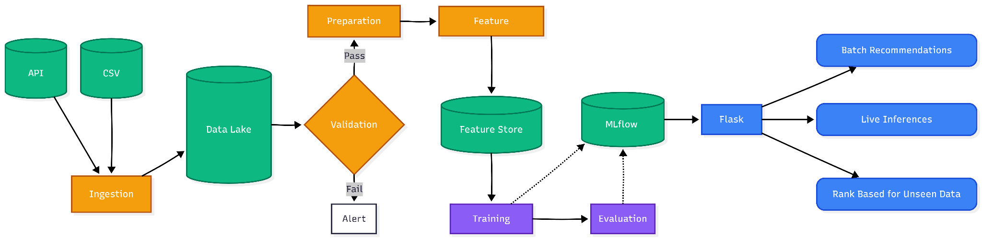
Pipeline Architecture & Tech Stack
Storage & Versioning: Local Data Lake, DVC, Git
Data Processing: Python (Pandas/Numpy)
Machine Learning: Scikit-Learn (KNN / Collaborative Filtering), MLflow
Orchestration: Prefect
Deployment: Flask REST API
Human: Great Expectations / Patience 😀

Slide 6
Task 1: Problem Formulation
Objective: Define the business goal and metrics
We established RecoMart's business context as an e-commerce startup needing to drive sales via personalization. This phase involved identifying key entities (users, items, transactions) and defining the technical requirements for a pipeline that outputs clean EDA datasets, engineered features, and a deployable inference interface. Along with integration of mlflow, perfect, & flask.
Input: RecoMart business requirements & source catalogs
Output: Business problem definition, strategies for planning and executing all Tasks 2 to Tasks 10

Slide 7
Task 2: Data Collection and Ingestion
Objective: Automate the fetching of raw data
We implemented modular Python scripts to pull data from two distinct sources: user interaction logs (CSV) and product metadata (REST API). The ingestion logic includes automated retries and detailed logging to ensure the pipeline is resilient to network or source failures
Tools Used: Python (ingestion/), Requests library
ingestion/ingest_csv.py → CSV batch ingestion script
ingestion/ingest_api.py → REST API ingestion script using Faker
Input: Local CSV logs & external REST API endpoints
Output: Raw data files in data_lake/raw and ingestion audit logs

Slide 8
Task 2: Data Collection and Ingestion
» python run_ingestion.py --mode csv
======================================================================
RecoMart - Data Ingestion Pipeline
Mode: CSV
======================================================================
>>> Running CSV Batch Ingestion ...
2026-04-24 22:40:02 | INFO | csv_ingestion | ======================================================================
2026-04-24 22:40:02 | INFO | csv_ingestion | CSV BATCH INGESTION - START
2026-04-24 22:40:02 | INFO | csv_ingestion | Timestamp : 2026-04-24T22:40:02.982277
2026-04-24 22:40:02 | INFO | csv_ingestion | Source dir: D:\Data\Portfolio\Projects\Python\e2e-pipeline\dataset
2026-04-24 22:40:02 | INFO | csv_ingestion | Raw layer : D:\Data\Portfolio\Projects\Python\e2e-pipeline\data_lake/raw
2026-04-24 22:40:02 | INFO | csv_ingestion | Files : 9
.
.
.
2026-04-24 22:40:06 | INFO | csv_ingestion | [OK] SUCCESS - product_category_name_translation.csv
2026-04-24 22:40:06 | INFO | csv_ingestion | ======================================================================
2026-04-24 22:40:06 | INFO | csv_ingestion | CSV BATCH INGESTION - COMPLETE
2026-04-24 22:40:06 | INFO | csv_ingestion | Total files : 9
2026-04-24 22:40:06 | INFO | csv_ingestion | Succeeded : 9
2026-04-24 22:40:06 | INFO | csv_ingestion | Failed : 0
2026-04-24 22:40:06 | INFO | csv_ingestion | ======================================================================
2026-04-24 22:40:06 | INFO | csv_ingestion | Run summary written to: D:\Data\Portfolio\Projects\Python\e2e-pipeline\logs\csv_ingestion_summary_20260424_224006.json
>>> CSV Ingestion complete: 9 succeeded, 0 failed.

Slide 9
Task 3: Raw Data Storage
Objective: Organize data in a scalable storage layer
We designed a local Data Lake that mimics professional cloud storage. Data is organized into a hierarchical structure partitioned by Source, Type, and Timestamp. This organization ensures high-performance retrieval and prevents data overwrites, maintaining a historical record of all ingested data
Tools Used: Local Filesystem / Data Lake (data_lake/) → storage/storage_manager.py
Input: Data streams from the Ingestion stage
Output: A structured, versioned directory layout for raw assets
data_lake/raw/ | Unprocessed ingested data
data_lake/staging/ | Post-validation (used by Task 4)
data_lake/curated/ | Transformed features (used by Tasks 5–6)
data_lake/serving/ | Model-ready data (used by Task 7)

Slide 10
Task 3: Raw Data Storage
» python -m storage.storage_manager
======================================================================
RecoMart - Data Lake Storage Manager
======================================================================
[1] Initializing data lake layers ...
2026-04-24 22:40:06 | INFO | storage_manager | Layer 'raw' -> D:\Data\Portfolio\Projects\Python\e2e-pipeline\data_lake\raw (Unprocessed data exactly as ingested from sources)
2026-04-24 22:40:06 | INFO | storage_manager | Layer 'staging' -> D:\Data\Portfolio\Projects\Python\e2e-pipeline\data_lake\staging (Validated and lightly cleaned data (post-quality checks))
2026-04-24 22:40:06 | INFO | storage_manager | Layer 'curated' -> D:\Data\Portfolio\Projects\Python\e2e-pipeline\data_lake\curated (Fully cleaned, transformed, feature-engineered data)
2026-04-24 22:40:06 | INFO | storage_manager | Layer 'serving' -> D:\Data\Portfolio\Projects\Python\e2e-pipeline\data_lake\serving (Model-ready features and inference outputs)
.
.
.
. » python -m storage.storage_manager --verify
[4] Verifying checksums ...
2026-04-24 22:40:07 | INFO | storage_manager | [OK] MATCH customers\csv\2026-04-24\olist_customers_dataset.csv
2026-04-24 22:40:07 | INFO | storage_manager | [OK] MATCH geolocation\csv\2026-04-24\olist_geolocation_dataset.csv
2026-04-24 22:40:07 | INFO | storage_manager | [OK] MATCH orders\csv\2026-04-24\olist_orders_dataset.csv
2026-04-24 22:40:07 | INFO | storage_manager | [OK] MATCH order_items\csv\2026-04-24\olist_order_items_dataset.csv
2026-04-24 22:40:07 | INFO | storage_manager | [OK] MATCH order_payments\csv\2026-04-24\olist_order_payments_dataset.csv
2026-04-24 22:40:07 | INFO | storage_manager | [OK] MATCH order_reviews\csv\2026-04-24\olist_order_reviews_dataset.csv
2026-04-24 22:40:07 | INFO | storage_manager | [OK] MATCH products\csv\2026-04-24\olist_products_dataset.csv
2026-04-24 22:40:07 | INFO | storage_manager | [OK] MATCH product_category_name_translation\csv\2026-04-24\product_category_name_translation.csv
2026-04-24 22:40:07 | INFO | storage_manager | [OK] MATCH sellers\csv\2026-04-24\olist_sellers_dataset.csv
Verified : 9
Mismatched : 0
Skipped : 0

Slide 11
Task 4: Data Profiling and Validation
Objective: Ensure high data quality before processing
We built automated "Quality Gates" using Pandas and schema validation logic. The system checks for null values, duplicate entries, and invalid rating ranges (e.g., verifying ratings are strictly between 1 to 5). A Data Quality Report is generated to provide a "health check" before any data enters the modeling stage
Tools Used: Python, Pandas
validation/validate_data.py
Input: Raw data from the Data Lake
Output: logs/validation.log & reports/data_quality_report.json

Slide 12
Task 4: Data Profiling and Validation
» python -m validation.validate_data
2026-04-24 22:40:08 | INFO | validation | ======================================================================
2026-04-24 22:40:08 | INFO | validation | DATA PROFILING & VALIDATION - START
2026-04-24 22:40:08 | INFO | validation | Timestamp : 2026-04-24T22:40:08.467624
2026-04-24 22:40:08 | INFO | validation | Raw layer : D:\Data\Portfolio\Projects\Python\e2e-pipeline\data_lake/raw
2026-04-24 22:40:08 | INFO | validation | Source : D:\Data\Portfolio\Projects\Python\e2e-pipeline\dataset
2026-04-24 22:40:08 | INFO | validation | ======================================================================
2026-04-24 22:40:08 | INFO | validation | Using latest ingested raw file: D:\Data\Portfolio\Projects\Python\e2e-pipeline\data_lake/raw\customers\csv\2026-04-24\olist_customers_dataset.csv
,
,
.
.
.
,
2026-04-24 22:40:14 | INFO | validation | -> Overall: PASS
2026-04-24 22:40:14 | INFO | validation | JSON report: D:\Data\Portfolio\Projects\Python\e2e-pipeline\reports\20260424_224014_data_quality_report.json
2026-04-24 22:40:14 | INFO | validation | Markdown report: D:\Data\Portfolio\Projects\Python\e2e-pipeline\reports\20260424_224014_data_quality_report.md
2026-04-24 22:40:14 | INFO | validation | ======================================================================
2026-04-24 22:40:14 | INFO | validation | DATA PROFILING & VALIDATION - COMPLETE
2026-04-24 22:40:14 | INFO | validation | Total datasets : 9
2026-04-24 22:40:14 | INFO | validation | PASS : 8
2026-04-24 22:40:14 | INFO | validation | WARNING : 1
2026-04-24 22:40:14 | INFO | validation | ERROR : 0
2026-04-24 22:40:14 | INFO | validation | ======================================================================

Slide 13
Task 5: Data Preparation & EDA
Objective: Transform raw data into a clean, usable format
This stage involves handling missing user interactions and encoding categorical attributes (like product categories) into numerical formats. We conducted Exploratory Data Analysis (EDA) to visualize user-item sparsity and item popularity, ensuring the data distributions are suitable for a recommendation engine
Tools Used: Jupyter Notebooks, Pandas, Matplotlib
preparation/prepare_data.py
Input: Validated raw data
Output:
Curated Datasets data_lake/curated
EDA plots reports/EDA
EDA Plots | Review Score Distribution
 | Top Categories
 | Item Popularity
 | User Activity Distribution
 | Monthly Purchase Volume
 | Purchase Heatmap
 | Price Distribution
 | Payment Type Distribution

Slide 14
Task 5: Data Preparation & EDA
» python -m preparation.prepare_data
2026-04-24 22:40:16 | INFO | preparation | ======================================================================
2026-04-24 22:40:16 | INFO | preparation | DATA PREPARATION & EDA - START
2026-04-24 22:40:16 | INFO | preparation | Timestamp : 2026-04-24T22:40:16.450927
2026-04-24 22:40:16 | INFO | preparation | Raw layer : D:\Data\Portfolio\Projects\Python\e2e-pipeline\data_lake/raw
2026-04-24 22:40:16 | INFO | preparation | ======================================================================
.
.
.
.
.
.
2026-04-24 22:40:23 | INFO | preparation | [6] Saving prepared datasets...
2026-04-24 22:40:27 | INFO | preparation | Transactions: D:\Data\Portfolio\Projects\Python\e2e-pipeline\data_lake\curated\prepared\2026-04-24\transactions.csv (110,840 rows)
2026-04-24 22:40:27 | INFO | preparation | Interactions: D:\Data\Portfolio\Projects\Python\e2e-pipeline\data_lake\curated\prepared\2026-04-24\user_item_interactions.csv (96,739 rows)
2026-04-24 22:40:27 | INFO | preparation | Products: D:\Data\Portfolio\Projects\Python\e2e-pipeline\data_lake\curated\prepared\2026-04-24\products_cleaned.csv (32,951 rows)
2026-04-24 22:40:28 | INFO | preparation | Customers: D:\Data\Portfolio\Projects\Python\e2e-pipeline\data_lake\curated\prepared\2026-04-24\customers_cleaned.csv (96,096 rows)
2026-04-24 22:40:28 | INFO | preparation | Summary: D:\Data\Portfolio\Projects\Python\e2e-pipeline\data_lake\curated\prepared\2026-04-24\20260424_224016_preparation_summary.json
2026-04-24 22:40:28 | INFO | preparation | ======================================================================
2026-04-24 22:40:28 | INFO | preparation | DATA PREPARATION & EDA - COMPLETE
2026-04-24 22:40:28 | INFO | preparation | Transactions : 110,840
2026-04-24 22:40:28 | INFO | preparation | Users : 93,263
2026-04-24 22:40:28 | INFO | preparation | Products : 32,216
2026-04-24 22:40:28 | INFO | preparation | Interactions : 96,739
2026-04-24 22:40:28 | INFO | preparation | Sparsity : 99.9968%
2026-04-24 22:40:28 | INFO | preparation | ======================================================================

Slide 15
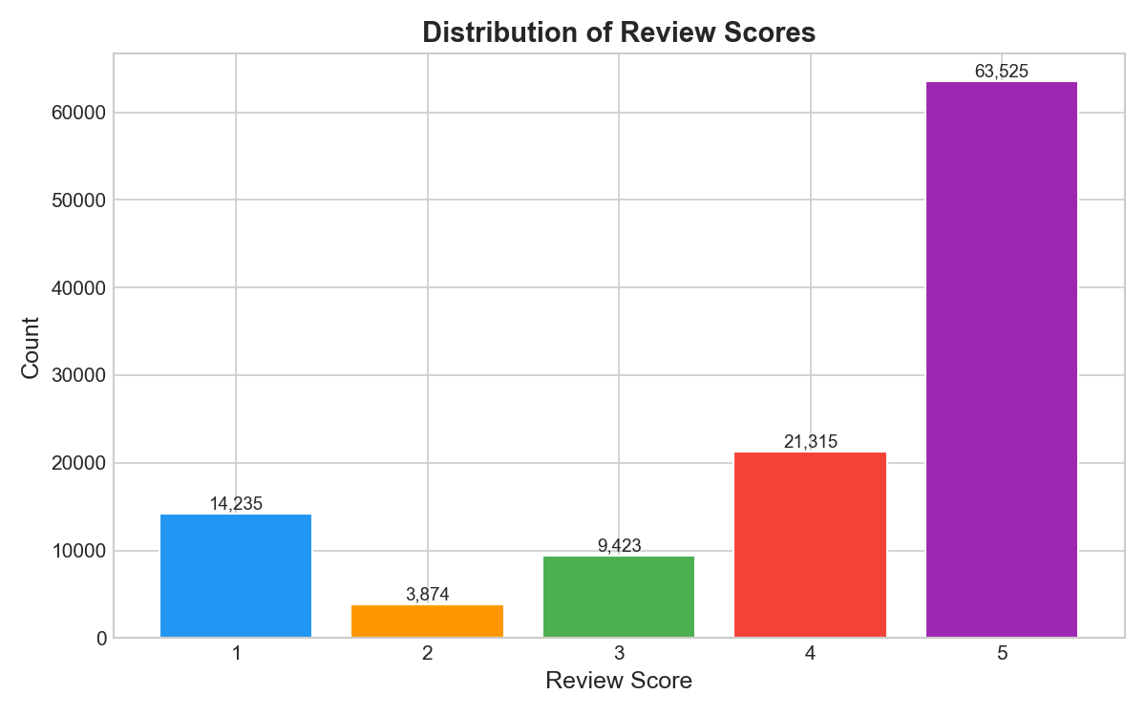
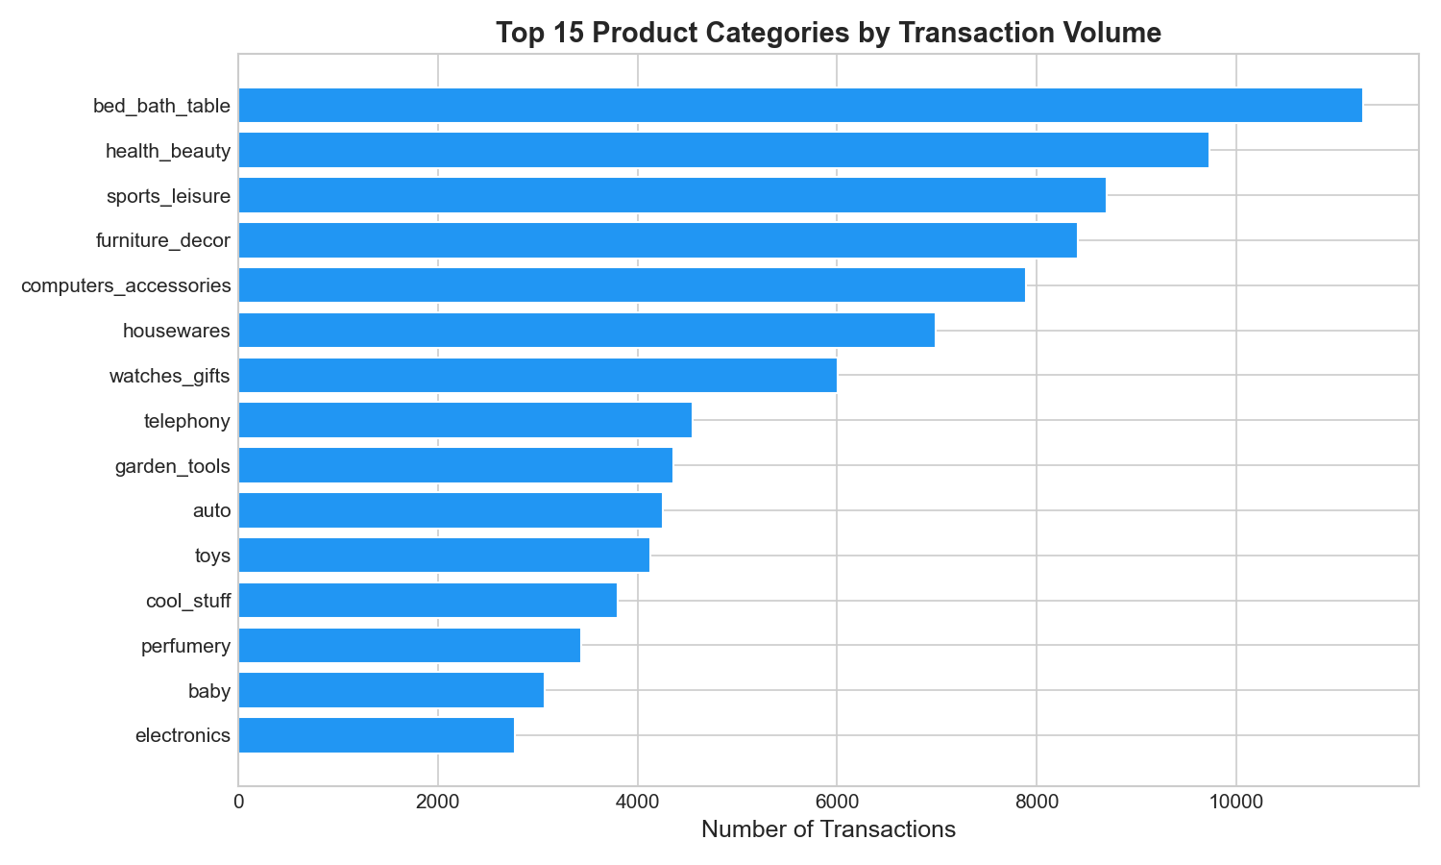
EDA Plots

Slide 16
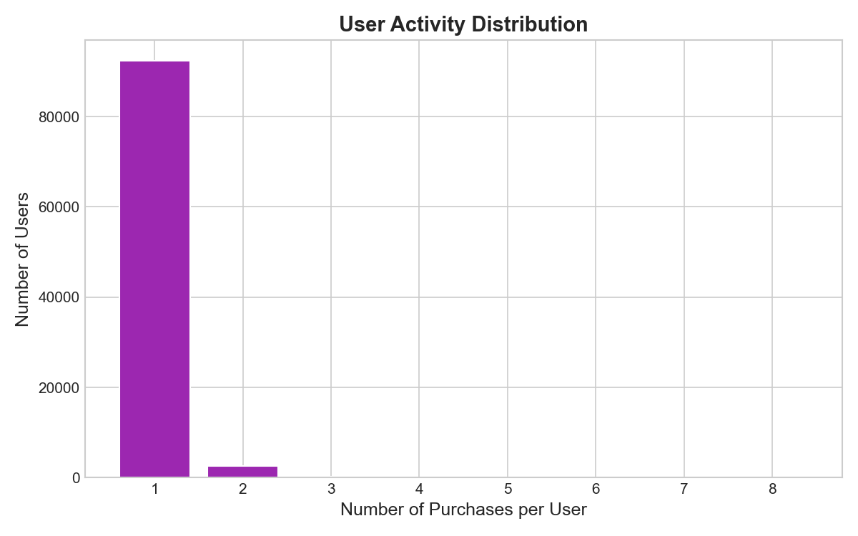
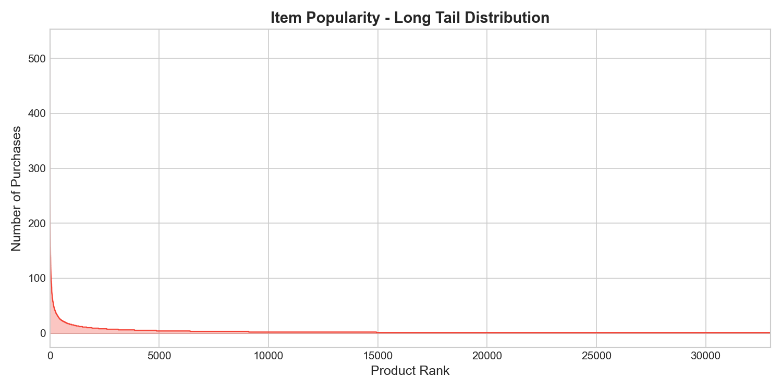
EDA Plots

Slide 17
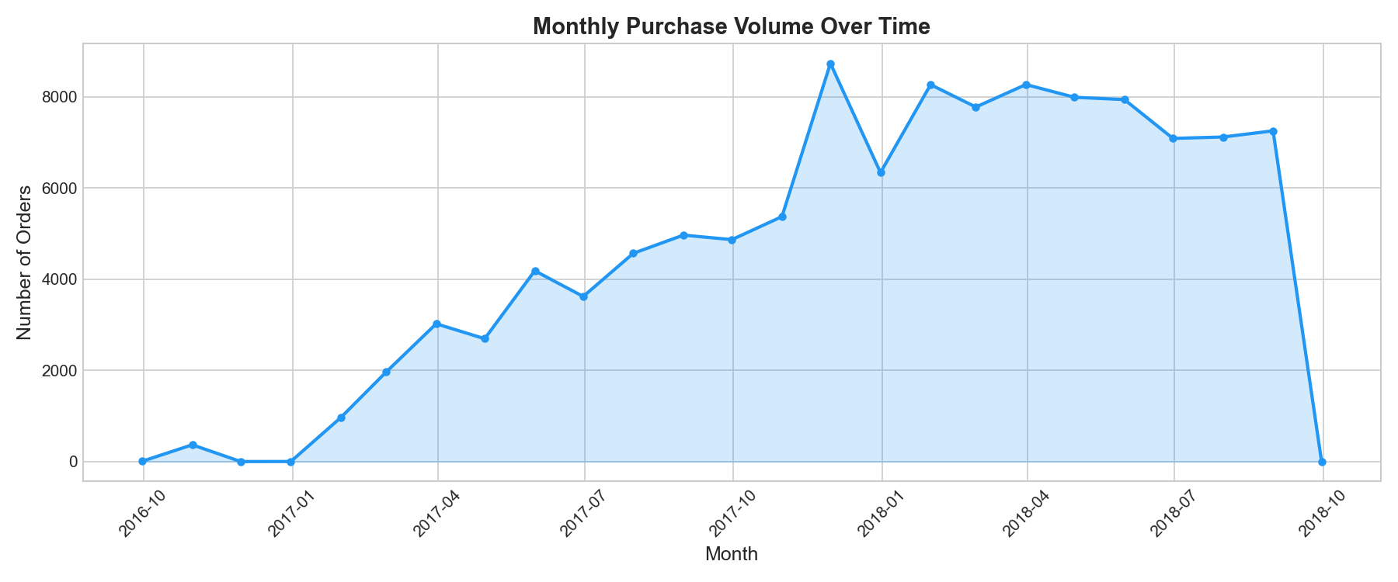
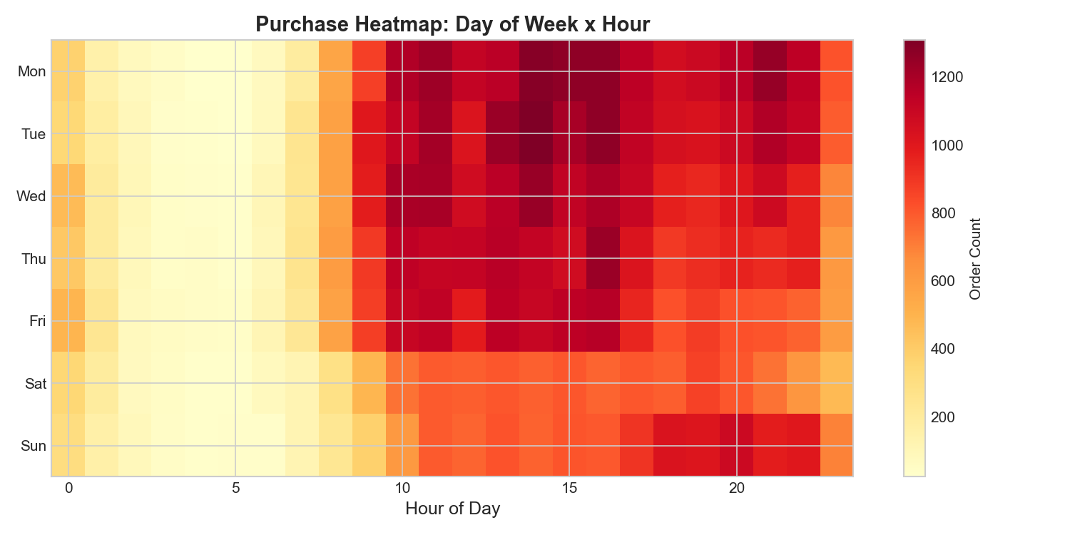
EDA Plots

Slide 18
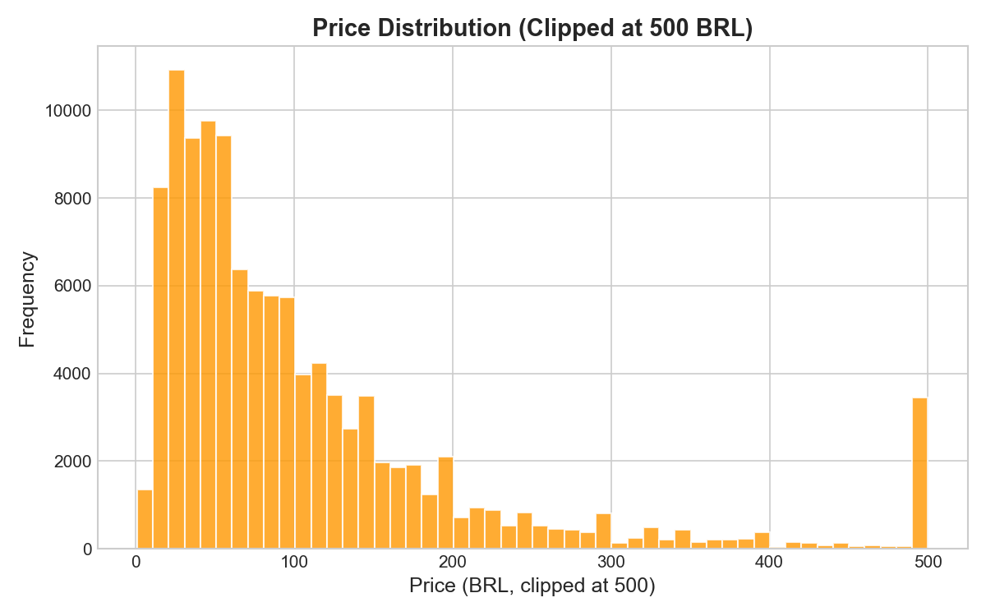
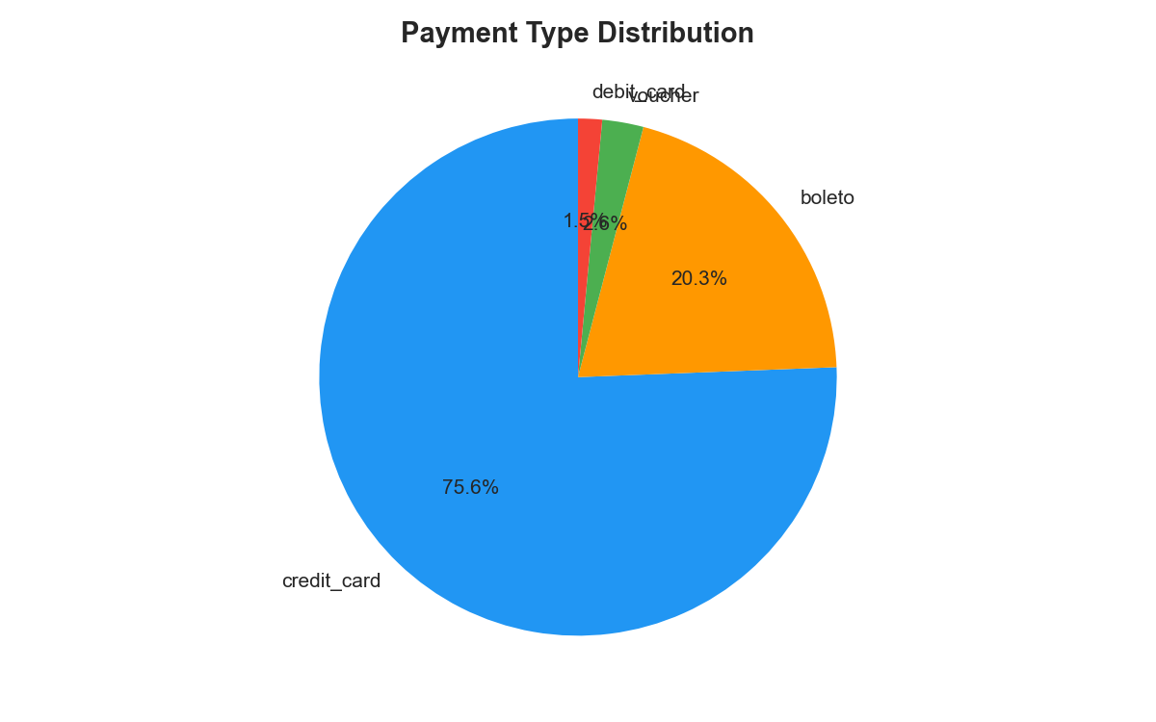
EDA Plots

Slide 19
Task 6: Feature Engr. & Transformation
Objective: Create predictive signals for the recommendation model
We converted raw behavioral data into mathematical features, such as user activity frequency and average rating per item. These features are transformed into matrices that represent user-item relationships, providing the essential "signals" needed for collaborative filtering
Tools Used: Python, SQL Transformation scripts, SQLite
transformation.feature_engineering
Input: Data from Task 5 data_lake/curated
Output:
Engineered feature sets data_lake/curated/features/csv
Defined SQL schemas data_lake/curated/features/features.db

Slide 20
Task 6: Feature Engr. & Transformation
» python -m transformation.feature_engineering
2026-04-24 22:40:29 | INFO | transformation | ======================================================================
2026-04-24 22:40:29 | INFO | transformation | FEATURE ENGINEERING - START
2026-04-24 22:40:29 | INFO | transformation | Timestamp : 2026-04-24T22:40:29.484144
2026-04-24 22:40:29 | INFO | transformation | Input : D:\Data\Portfolio\Projects\Python\e2e-pipeline\data_lake\curated\prepared\2026-04-24
2026-04-24 22:40:29 | INFO | transformation | Output : D:\Data\Portfolio\Projects\Python\e2e-pipeline\data_lake\curated\features\2026-04-24
2026-04-24 22:40:29 | INFO | transformation | ======================================================================
2026-04-24 22:40:29 | INFO | transformation | [1] Loading prepared datasets...
.
.
.
2026-04-24 22:41:29 | INFO | transformation | [SQLITE] Loading features into: D:\Data\Portfolio\Projects\Python\e2e-pipeline\data_lake\curated\features\2026-04-24\features.db
2026-04-24 22:41:30 | INFO | transformation | user_features: 93,263 rows
2026-04-24 22:41:30 | INFO | transformation | item_features: 32,216 rows
2026-04-24 22:41:30 | INFO | transformation | interaction_features: 96,739 rows
2026-04-24 22:41:30 | INFO | transformation | feature_registry: 33 entries
2026-04-24 22:41:31 | INFO | transformation | Indexes created
2026-04-24 22:41:31 | INFO | transformation | SQLite database saved successfully
2026-04-24 22:41:31 | INFO | transformation | [8] Generating feature logic summary...
2026-04-24 22:41:31 | INFO | transformation | Feature summary: D:\Data\Portfolio\Projects\Python\e2e-pipeline\reports\feature_logic_summary.md
2026-04-24 22:41:31 | INFO | transformation | ======================================================================
2026-04-24 22:41:31 | INFO | transformation | FEATURE ENGINEERING - COMPLETE
2026-04-24 22:41:31 | INFO | transformation | User features : 93,263 rows x 16 cols
2026-04-24 22:41:31 | INFO | transformation | Item features : 32,216 rows x 28 cols
2026-04-24 22:41:31 | INFO | transformation | Interaction features : 96,739 rows x 7 cols
2026-04-24 22:41:31 | INFO | transformation | SQLite DB : D:\Data\Portfolio\Projects\Python\e2e-pipeline\data_lake\curated\features\2026-04-24\features.db
2026-04-24 22:41:31 | INFO | transformation | ======================================================================

Slide 21
Task 7: Feature Store
Objective: Centralize feature management for Training and Inference
We implemented a metadata registry to manage feature versions. This ensures "training-serving consistency," meaning the exact same feature logic used to train the model is available to the inference API. This prevents discrepancies between the model's environment and the production environment
Tools Used: Feature Store Manager
feature_store/feature_store_manager.py
Input: Transformed features from Task 6
Output:
Feature metadata data_lake/serving/feature_store/features.db
Versioned training set data_lake/serving/training_sets

Slide 22
Task 7: Feature Store
» python -m feature_store.feature_store_manager --register
2026-04-24 22:41:32 | INFO | feature_store | [REGISTER] Creating snapshot: v_20260424_224132
2026-04-24 22:41:32 | INFO | feature_store | Source DB: D:\Data\Portfolio\Projects\Python\e2e-pipeline\data_lake\curated\features\2026-04-24\features.db
» python -m feature_store.feature_store_manager --status
Store location : D:\Data\Portfolio\Projects\Python\e2e-pipeline\data_lake\serving\feature_store
Created : 2026-04-24T22:41:32.451302
Snapshots : 1
Latest : v_20260424_224132
» python -m feature_store.feature_store_manager --training-set
2026-04-24 22:41:34 | INFO | feature_store | [TRAINING] Building training set from D:\Data\Portfolio\Projects\Python\e2e-pipeline\data_lake\serving\feature_store\v_20260424_224132\features.db
2026-04-24 22:41:34 | INFO | feature_store | Training set: 1573 rows x 7 features
» sqlite3 "data_lake\serving\feature_store\v_20260424_224132\features.db" "SELECT DISTINCT customer_unique_id FROM user_features LIMIT 20;"
✔ Resolved users → 0000366f3b9a7992bf8c76cfdf3221e2, 0000b849f77a49e4a4ce2b2a4ca5be3f
» python -m feature_store.feature_store_manager --query-users "0000366f3b9a7992bf8c76cfdf3221e2, 0000b849f77a49e4a4ce2b2a4ca5be3f"
2026-04-24 22:41:36 | INFO | feature_store | [INFERENCE] Retrieved 2 user feature rows for 2 user IDs
» sqlite3 "data_lake\serving\feature_store\v_20260424_224132\features.db" "SELECT DISTINCT product_id FROM item_features LIMIT 20;"
✔ Resolved items → 00066f42aeeb9f3007548bb9d3f33c38, 00088930e925c41fd95ebfe695fd2655
» python -m feature_store.feature_store_manager --query-items "00066f42aeeb9f3007548bb9d3f33c38, 00088930e925c41fd95ebfe695fd2655"
2026-04-24 22:41:38 | INFO | feature_store | [INFERENCE] Retrieved 2 item feature rows for 2 item IDs

Slide 23
Task 8: Data Versioning and Lineage
Objective: Track the history and evolution of datasets
Using DVC (Data Version Control), we created a system where large datasets are versioned alongside the code. By linking specific data snapshots to Git commits, we established a clear lineage, allowing us to reproduce any specific model version by rolling back to its exact data state
Tools Used: Git, DVC
Input: Raw and transformed data assets
Output: .git & .dvc pointer files and data lineage documentation

Slide 24
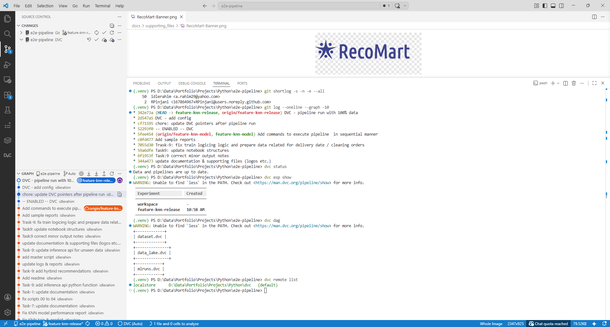
Git & DVC Version Control Setup

Slide 25
Task 9: Model Training and Evaluation
Objective: Develop and evaluate the recommendation engine
We trained a K-Nearest Neighbors (KNN) model for collaborative filtering, using vectorized operations to optimize performance. The model is evaluated using ranking metrics (Precision@K, Recall@K, NDGC@K) with negative sampling to ensure realistic performance scores. All runs and artifacts are tracked in MLflow
Tools Used: Scikit-Learn (KNN), MLflow, Flask
models/model_training.py
models/evaluation_metrics.py
Input: Features from the Feature Store
Output:
Trained model artifacts mlruns
Performance tracking reports

Slide 26
Task 9: Model Training and Evaluation
» python -m models.model_training
2026/04/25 08:54:28 WARNING mlflow.sklearn: Saving scikit-learn models in the pickle or cloudpickle format requires exercising caution because these formats rely on Python's object serialization mechanism, which can execute arbitrary code during deserialization. The recommended safe alternative is the 'skops' format. For more information, see: https://scikit-learn.org/stable/model_persistence.html
2026/04/25 08:54:28 WARNING mlflow.sklearn: Model was missing function: predict. Not logging python_function flavor!
Starting RocoMart Model Training Pipeline
Loading product features from product categories with translated names: dataset/olist_products_dataset.csv
Training KNN model (User-Based on Categories)...
Loading product features from fallback dataset: dataset/olist_products_dataset.csv
Users with 2+ categories: 728
KNN (Category User-Based) - Precision@5: 0.0412, Recall@5: 0.2059, NDCG@5: 0.1616
Performance report saved to: reports/20260425_085442_model_performance_report.md
Training pipeline completed successfully!
Evaluation Metrics
Model | Precision@5 | Recall@5 | NDCG@5
KNN | 0.0412 | 0.2059 | 0.1616

Slide 27
Task 9: Model Training and Evaluation
Evaluation Metrics:
The KNN recommendation engine was evaluated against a held-out set of real customer purchase data.
Across the top 5 category recommendations presented to each customer, the model correctly identifies a category the customer genuinely likes approximately 20% of the time; surfacing 1 in 5 hidden interests within a single recommendation panel.
When a match is found, the ranking algorithm ensures it appears near the top of the list (NDCG: 0.16) rather than buried at the bottom.
In an e-commerce catalogue spanning 70+ categories, these scores translate directly to higher cross-category click-through rates, increased basket sizes, and improved customer discovery of categories they would not have otherwise visited
Model | Precision@5 | Recall@5 | NDCG@5
KNN | 0.0412 | 0.2059 | 0.1616

Slide 28
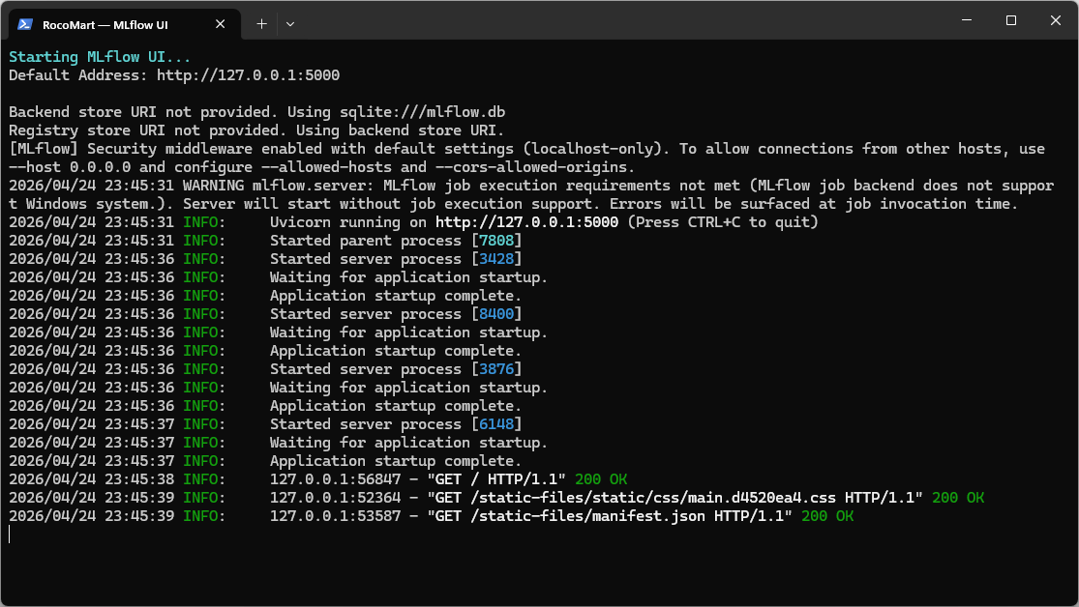
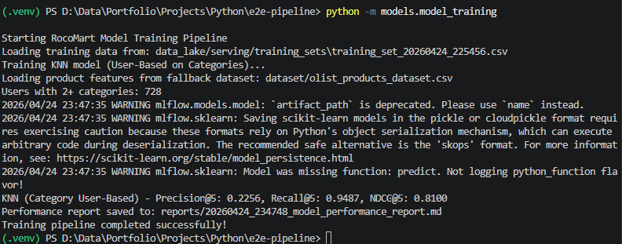
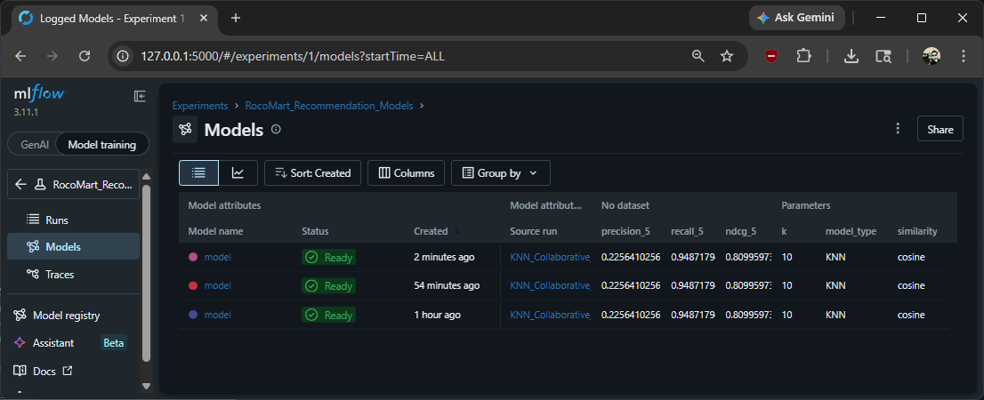
MLFlow

Slide 29
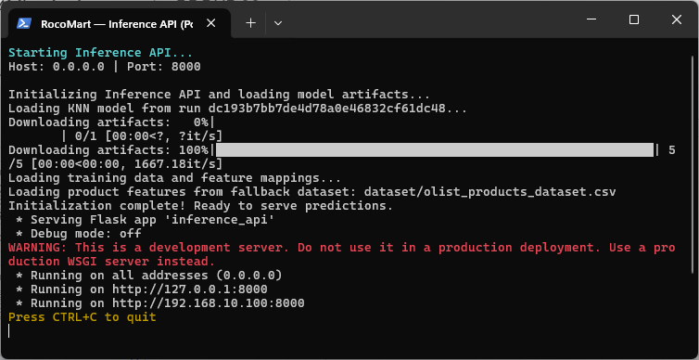
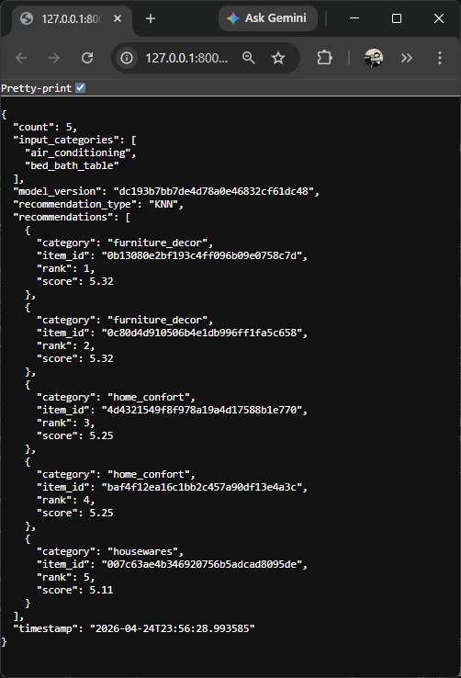
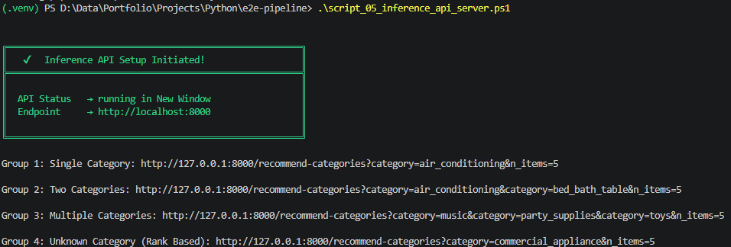
Inference API using Flask

Slide 30
Task 10: Pipeline Orchestration
Objective: Automate the entire workflow into a single DAG
We used Prefect to tie all nine previous tasks into a single automated workflow. The Directed Acyclic Graph (DAG) manages task dependencies, ensuring that training only begins if data validation passes. This provides a "single-click" execution model for the entire end-to-end data pipeline
Ingestion
Validation
Transformation
Training
Tools Used: Prefect orchestration/pipeline_flow.py & prefect.yaml
Input: All modular pipeline scripts
Output: An automated, monitored execution graph (DAG)

Slide 31
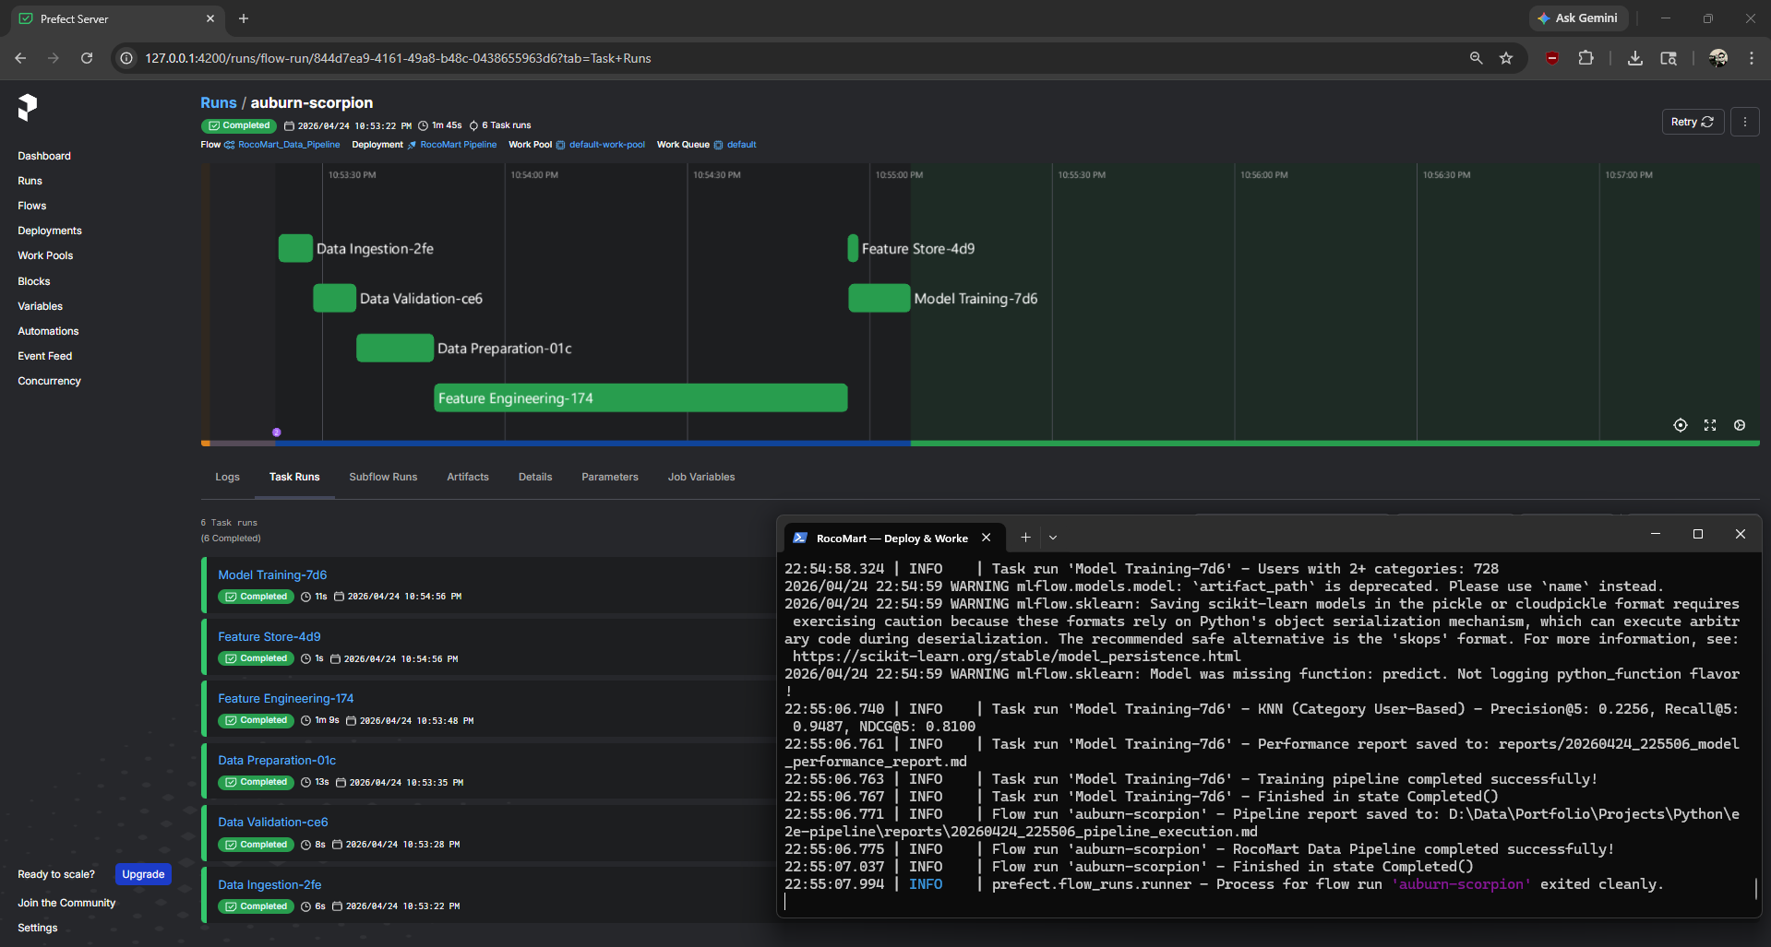
Perfect Server

Slide 32
Thank you!

